Slide 1

3 BY 3 RUBIK’S CUBE
HOW TO SLOVE CUBES

Slide 2
TYPES OF RUBIK’S CUBES
4 BY 4 RUBIK’S CUBES
3 BY 3 RUBIK’S CUBES
2 BY 2 RUBIK’S CUBES
1 BY 1 RUBIK’S CUBES
TRIANGLE CUBES...

Slide 3
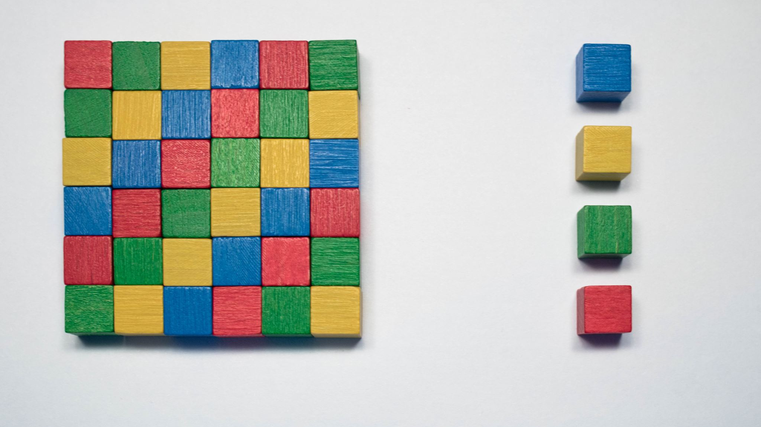
4 BY 4 RUBIK’S CUBES
Remaining four centers…
Pairing the edges. ...
Solve it like a 3x3. ...
Parity cases.

Slide 4
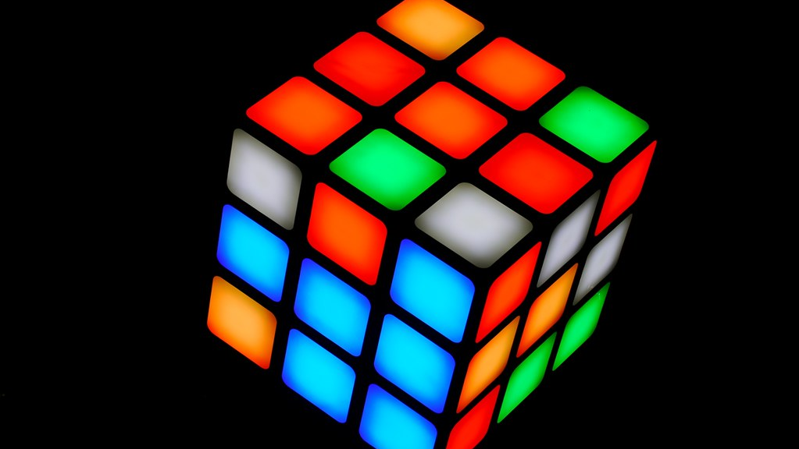
3 BY 3 RUBIK’S CUBES..
Solve the white cross on the bottom. ...
Solve the four corner pieces on the bottom. ...
Solve the four edge pieces in the middle layer. ...
Solve the yellow edges on the top layer. ...

Slide 5

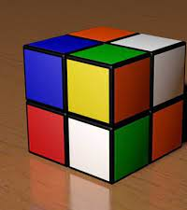
2 BY 2 RUBIK’S CUBES…
Find the GREEN/WHITE/RED corner.
Hold the cube with the GREEN/WHITE/RED corner in the front top left position with the WHITE ON TOP. ...

Slide 6

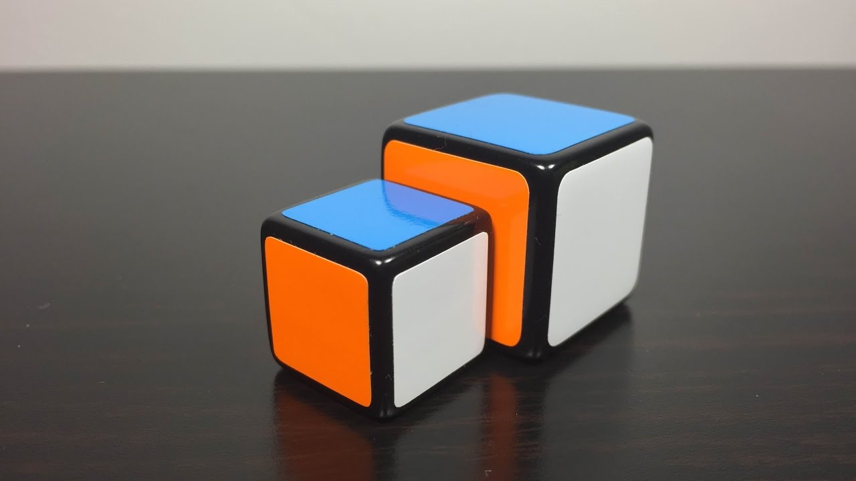



1 BY 1 RUBIK’S CUBES

Slide 7

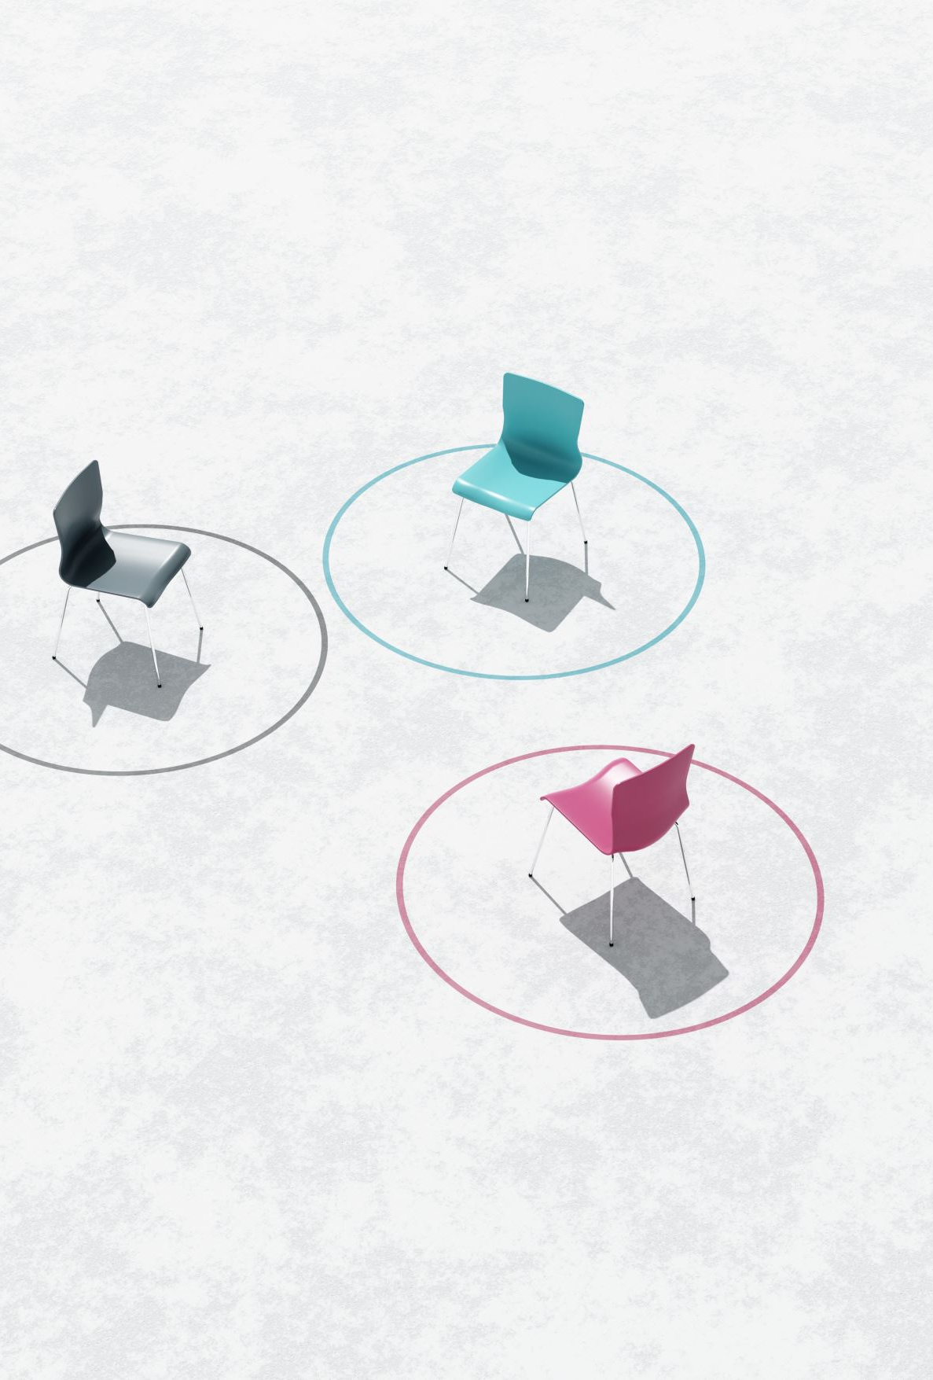
Move Notation CUBES
F (Front): the side currently facing the solver
B (Back): the side opposite the front
U (Up): the side above or on top of the front side
D (Down): the side opposite the top, underneath the Cube
L (Left): the side directly to the left of the front
R (Right): the side directly to the right of the front

Slide 8

BENEFITS OF RUBIK’S CUBES
INCREASE IQ LEVEL..
CONCENTRATION…
IMPROVE YOUR MEMORY…
IMPROVE SPEED

Slide 9
THANK YOU

